Slide 1
UGV Design Modular Mobile Platform Bardia Mojra

Slide 2
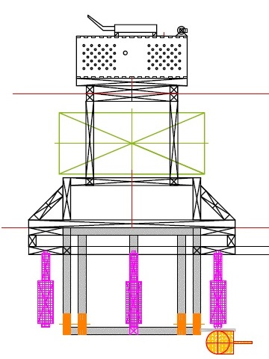
Outline
Overview
Quiz
UGV system
General hardware
Interface and control
Variations
Drive systems
Applications
Available platforms
Off-the-shelf
Challenges
SOC solution
Features
Credits
Answer

Slide 3
Quiz
Why?

Slide 4
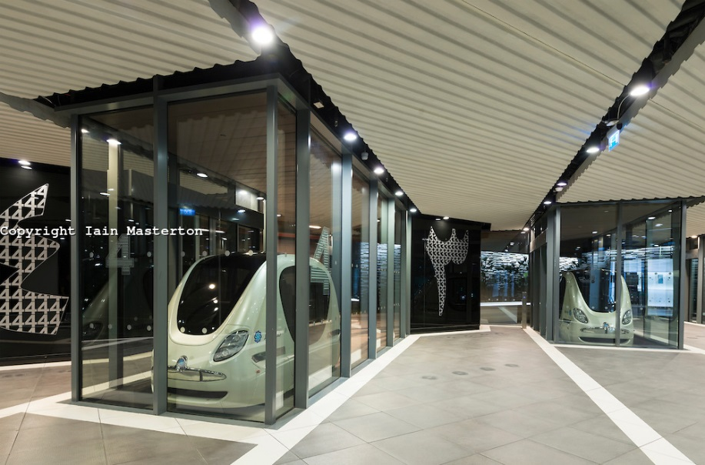
UGV Application
Military
Agriculture
Police
Warehouse automation
Local logistics
Hospital logistics
Human transportation networks

Slide 5
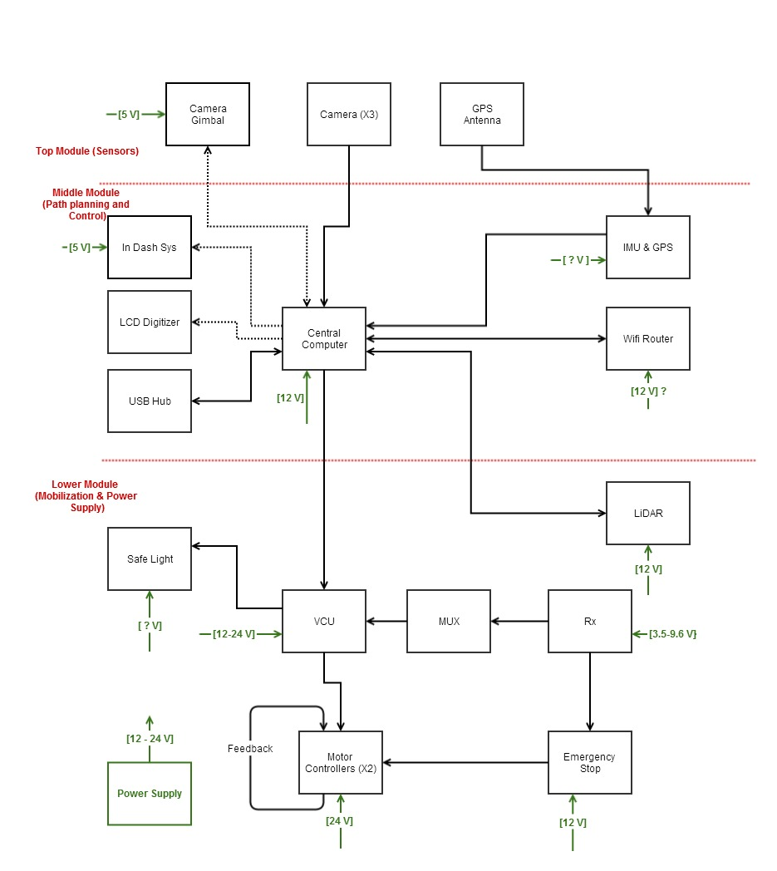
Hardware
Motors and encoders
E-Stop
Safety light
Satellite receiver
VCU
SBC (VNU)
Sensor package
Power system

Slide 6
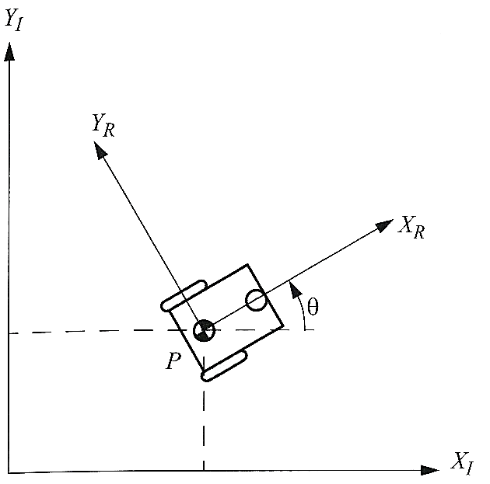
Interface & Processing
Platform
100 Mbit/s 802.3 Ethernet
802.11b/g wireless data link
VCU (Vehicle Control Unit)
RS232 serial DB9
Ethernet RJ45
UART for DSMX remote receiver
JTAG IC debug port for on-board programming
SBC
USB, SATA, Mini-PCIe, GLAN, LVDS, VGA, HDMI
Quad core AMD
60GB SSD
4GB RAM

Slide 7
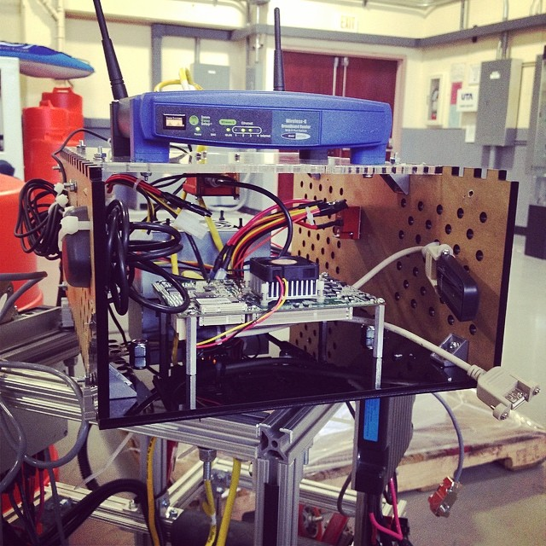
Upper Module

Slide 8
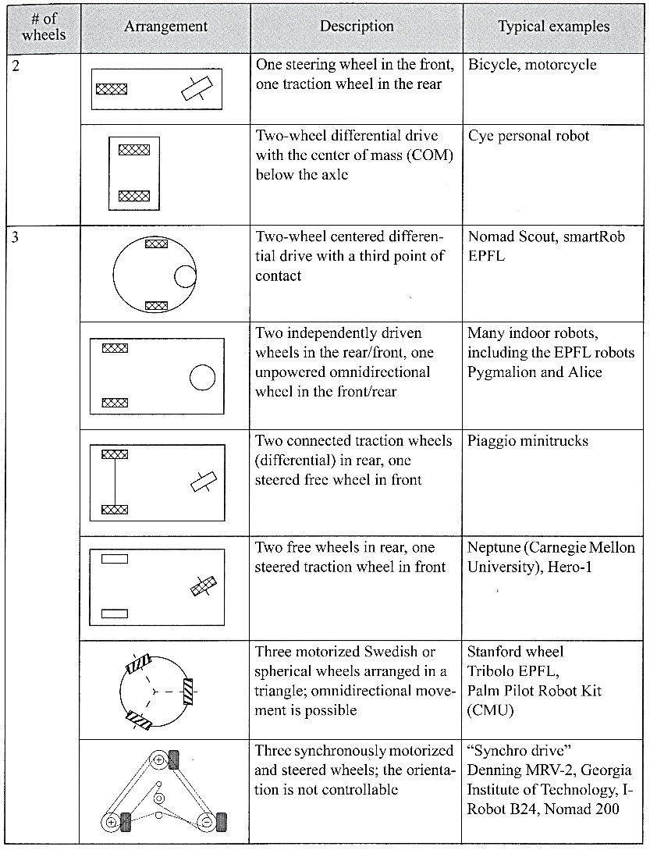
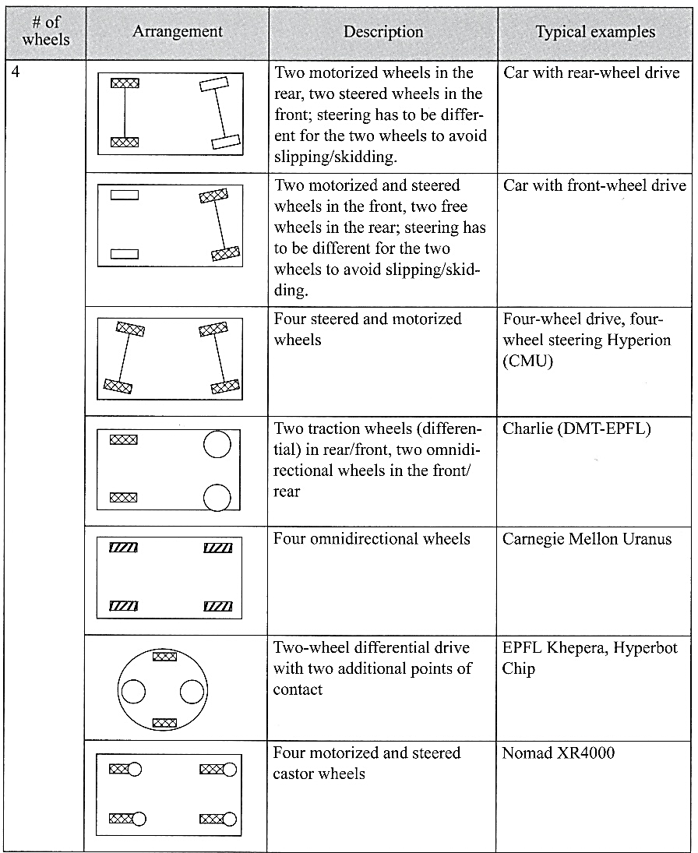
Drive Systems (1/2)

Slide 9
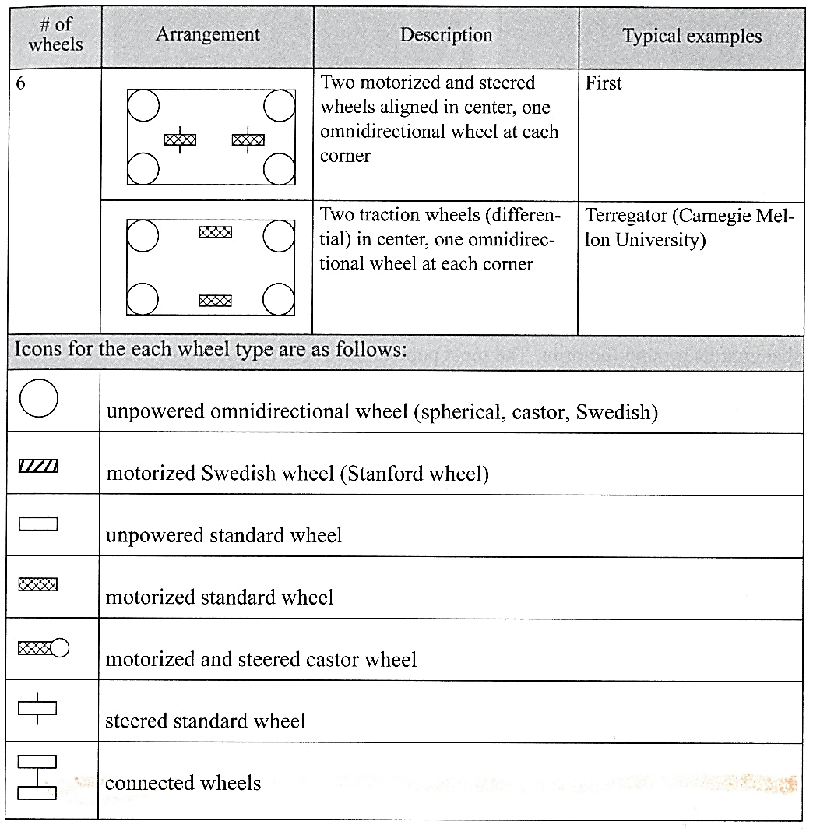
Drive Systems (2/2)

Slide 10
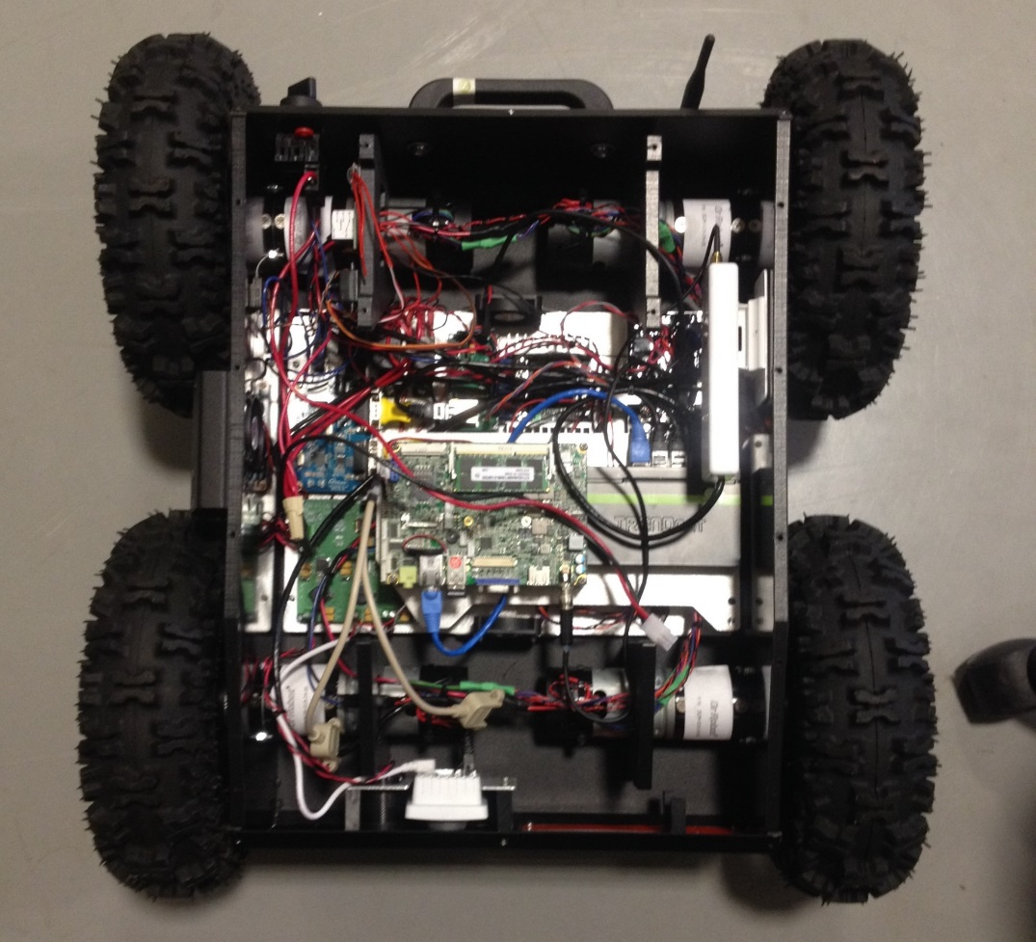
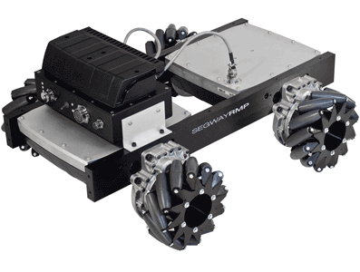
Other Platforms
Jaguar 4x4
Segway

Slide 11
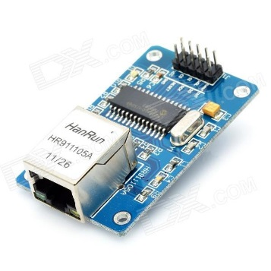
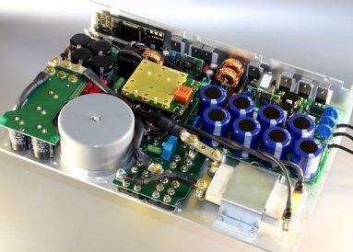
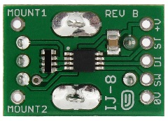
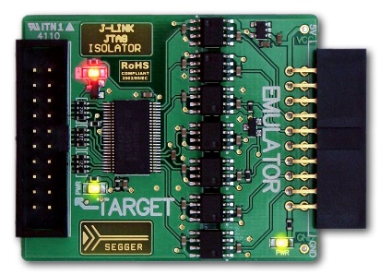
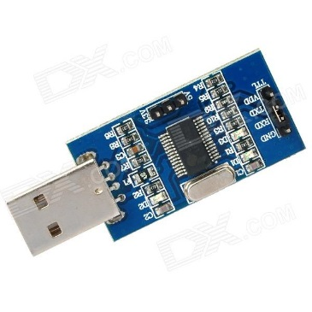
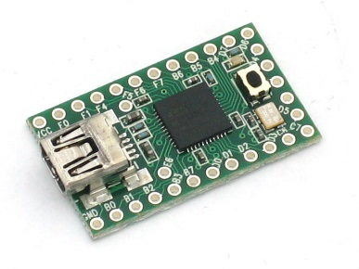
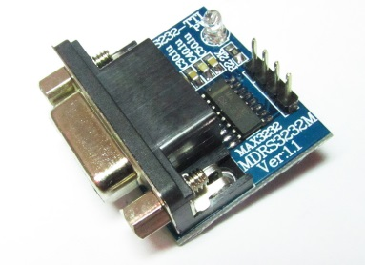
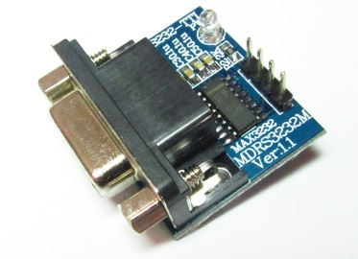
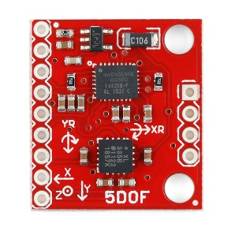
Off-The-Shelf
Need to integrate many subsystems
More possible bugs and hardware issues
More expensive
Take more space
Interfacing
More parts to go burn and go wrong
Harder to prototype
Takes longer to assemble

Slide 12
Challenges
Interconnectivity
Industry standards
Developer tool kit
Too many variations and so different

Slide 13
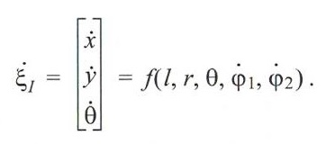
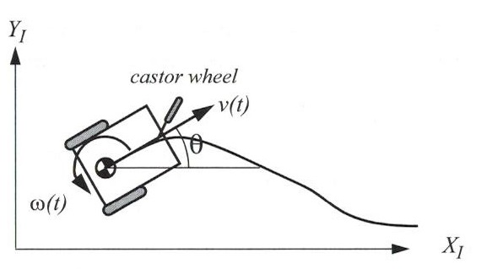
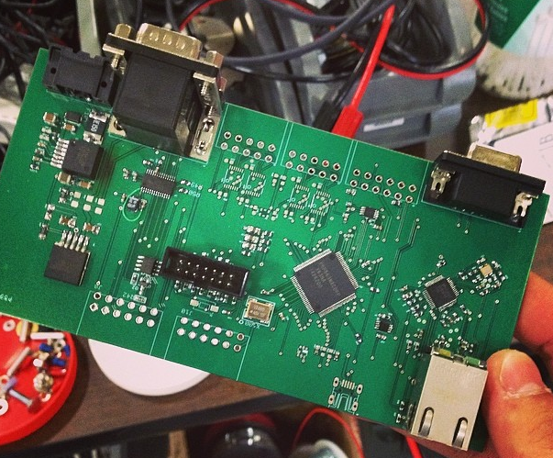
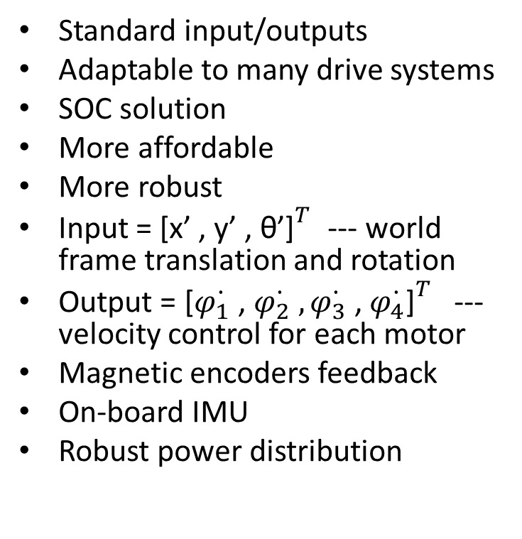
VCU
Standard input/outputs
Adaptable to many drive systems
SOC solution
More affordable
More robust
Input = ${\text{[}\text{x}\text{’ , }\text{y}\text{’ , }\text{θ}\text{’]}}^{T}$ --- world frame translation and rotation
Output = ${\text{[}φ_{1}^{∙}\text{ , }φ_{2}^{∙} ,φ_{3}^{∙}\text{ , }φ_{4}^{∙}\text{]}}^{T}$--- velocity control for each motor
Magnetic encoders feedback
On-board IMU
Robust power distribution

Slide 14
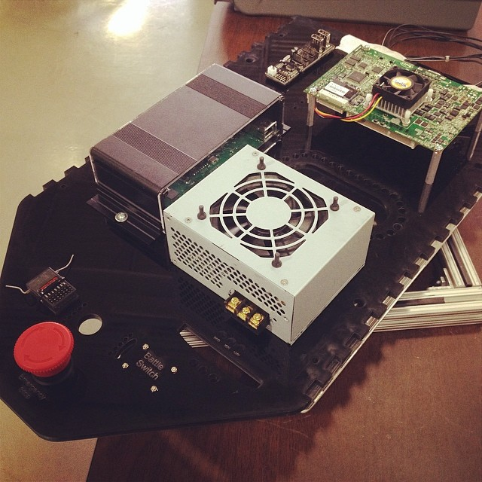
Less Parts

Slide 15
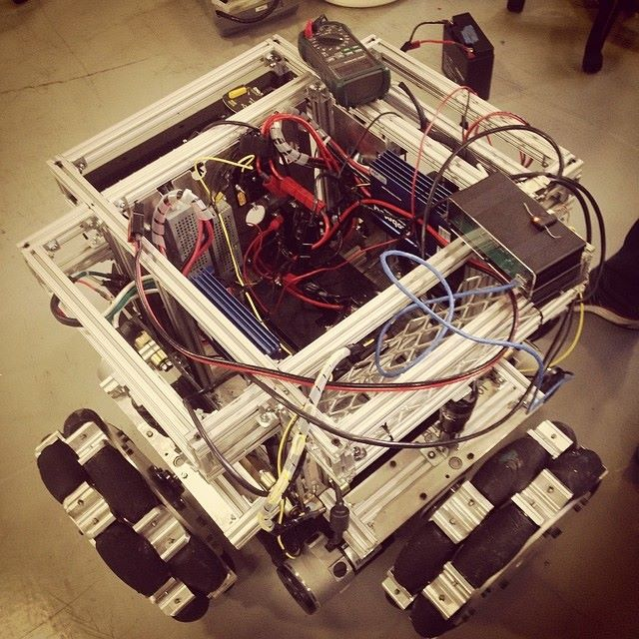
Features
Tele-op ready
Encoder feedback
Independent mobile platform
Tele-op not vulnerable if SBC crashes
No need for Voltage step down
Tested and proven
Ease of use and compatibility

Slide 16
Credits
VCU: Matt Middleton
Autonomous Mobile Robots, The MIT Press
Google!!

Slide 17
Quiz: Answer
Good potential
Encourage open discussion and reasoning with the team
Constructive feedback
Ideas spark ideas

Slide 18
Questions
?

